Slide 1

Introduction to Academic Work in Germany
Roxana Burciu, Ahmet Celikten, Christina Groß-Bölting, Ines Schäfer
October 21st, 2020, Wednesday
13.30 – 15.00

Slide 2
Content
Eduroam, VPN, ZEDAT-Portal & Blackboard
Exams and How to Write a Term Paper
Plagiarism
Additional Courses and Resources

Slide 3
I) Eduroam, VPN, ZEDAT-Portal & Blackboard

Slide 4
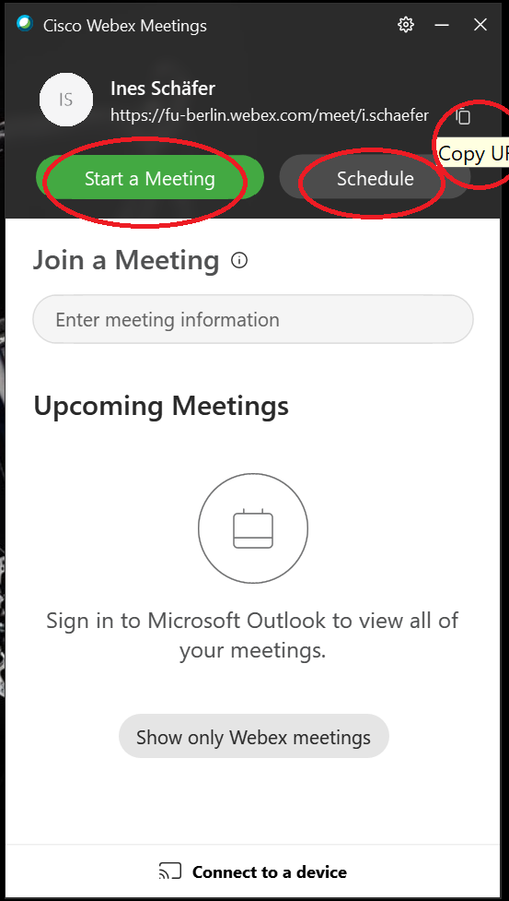

Slide 5
Eduroam
Internet connection in whole FU campus for your personal devices (PCs, Tablets, Mobile Phones)
You may also connect to internet in many other academic institutes around the World

Slide 6


Slide 7
Eduroam
Eduroam Configuration
Zedat Link (in German):
  https://www.zedat.fu-berlin.de/WLAN
On this website, you will find links to installation packages for each operating system (OS)
In addition, there is a helpful information booklet as pdf (in German, however the pictures in it are actually quite sufficient to follow required installation steps)

Slide 8
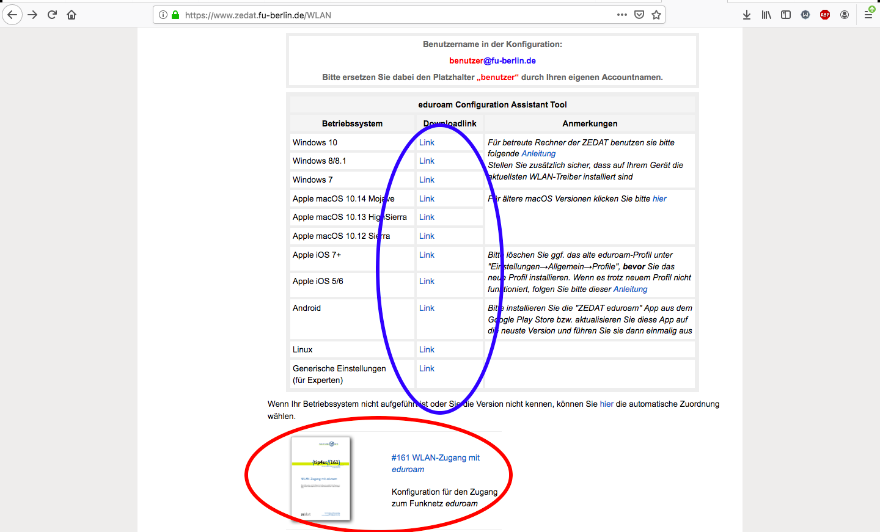

Slide 9
Eduroam
Required steps:
Open the downloaded installation package
Fill the “Benutzername” field with username@fu-berlin.de
Please be aware that username here is not same with Name.Surname@fu-berlin.de (usual email address)
Insert your password and proceed to the next steps
Important:
  Windows Phone/Mobile and Windows XP are not supported!
  If you already have an eduroam profile in your device, don’t forget to deinstall it first before following these steps!

Slide 10
Virtual Private Network (VPN)
Connect to the campus network from home
Useful to access e-books and online journals, and other FU services outside of the campus.
Install VPN software via the university website. Please check: https://www.zedat.fu-berlin.de/VPN
On the website, there is an information booklet available – again in German only – but with detailed pictures to understand in any language.
You may find detailed information about installation and usage in the Welcome Brochure.
Important to disconnect from VPN after usage for safety reasons and for the sake of a more stable internet connection.

Slide 11
Zedat-Portal
Main system for administrative and academic procedures at FU
Includes several services such as:
  Webmail
  Printing service
  Administrative services
  Campus Management
  Blackboard
  Software

Slide 12
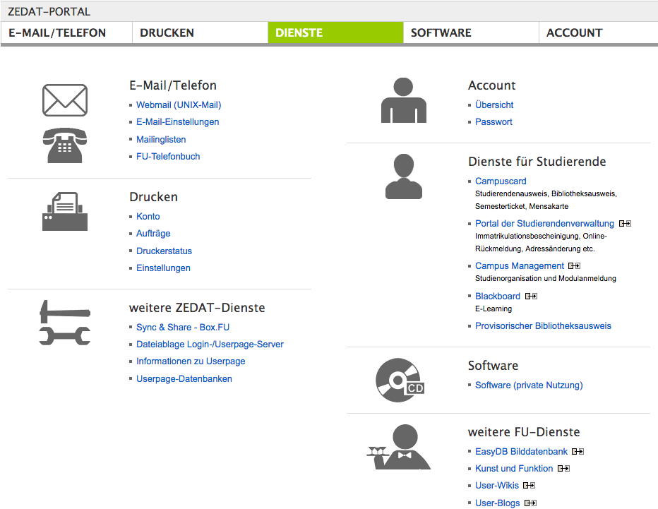

Slide 13
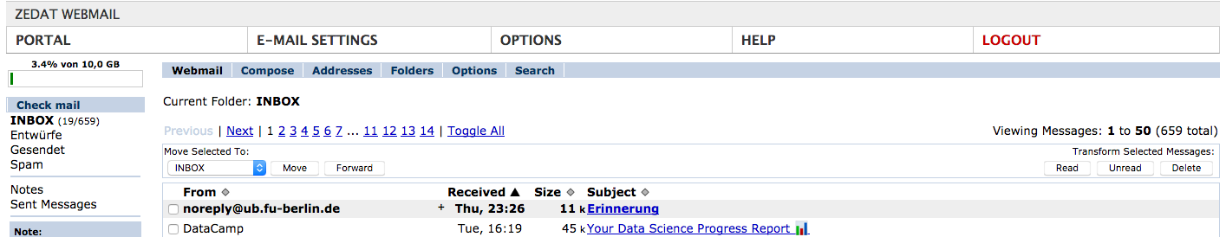
Zedat-Portal
Webmail
Most of the communication will be conducted via this email address
English language option is available with some exceptions
Changing the name of the email address
Forwarding Emails to another Account

Slide 14
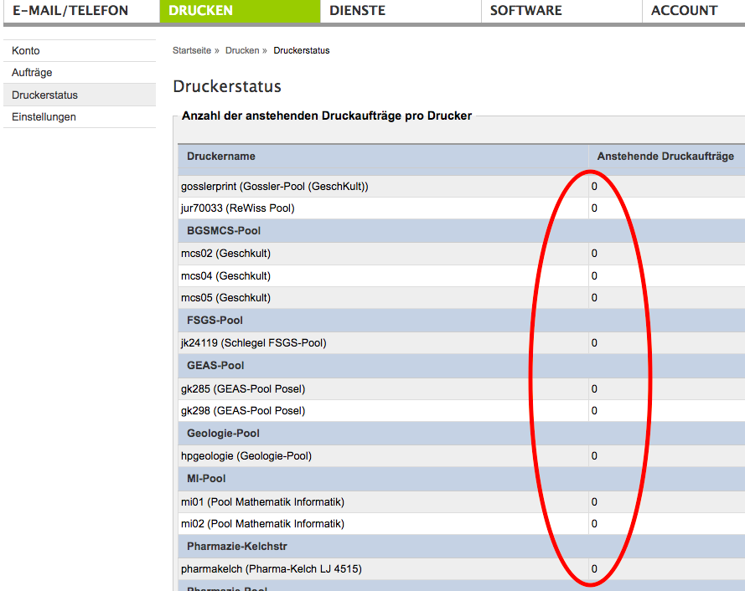
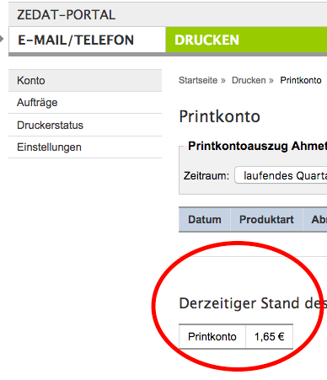
Zedat-Portal
!!! Due to recent restrictions, printing service and PC pools in Zedat Service (Silberlaube JK27) are currently closed until further notice.
Printing service (Drucken)
In this page, you could see current state of your printing account and remained amount
Besides, current status of the printers in Zedat could be checked and printing order could be sent accordingly

Slide 15

Zedat-Portal
Administrative services
Main purposes of use:
  Rückmeldung / Registration to next semester
  Downloading Student Certificate of enrolment (“Immatrikulationsbescheinigung”)
  Address change (important to change if you move)
  Etc.

Slide 16
Zedat-Portal
Campus Management
Registering for courses and modules at the beginning of each semester
  Registration deadline: 30.10.2020, 23:59
Checking the overview of grades and the status of previous courses
Looking at the current weekly plan of the ongoing semester
Calculate your current final grade (average of all classes taken together)
Print an overview of your obtained grades and classes you passed (transcript of records) → only in German; for an English version, please contact the examination office
Solely in German

Slide 17
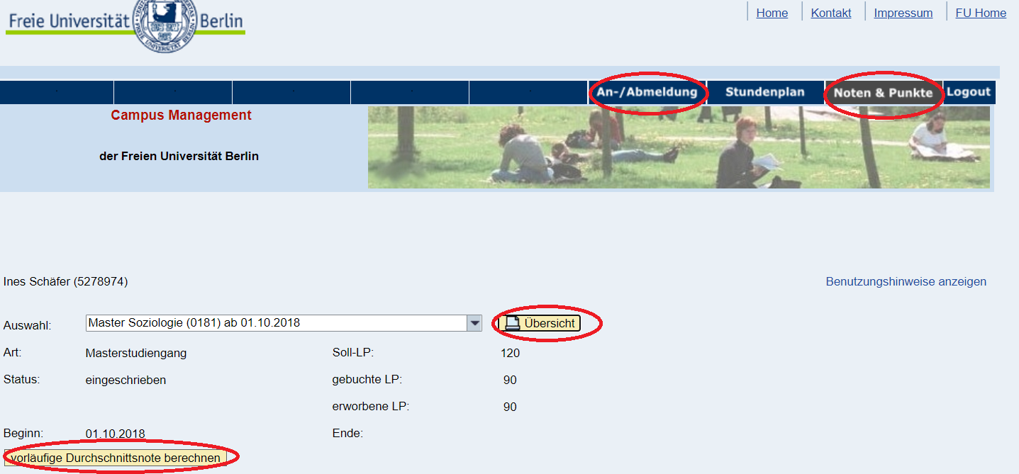

Slide 18
Zedat-Portal
Blackboard
The most important section of Zedat-Portal
All course material, announcements, working groups, discussion forum
Email sending options to other participants either separately or as a whole
You may also find courses with the search tool and register for their portal with/without password in order to benefit from course material during semester
English and German interface options

Slide 19
Zedat-Portal
Software
In this page, you may find wide range of software links
  Cisco AnyConnect VPN
  EndNote
  Citavi
  MS Office
  MATLAB
  Stata (new!)
Some of them (e.g. Microsoft Office) are free of charge, after providing required information regarding student status

Slide 20
II) Exams and How to Write a Term Paper

Slide 21
Grades
For each module (lecture + seminar) you will get one grade and one passed/failed qualificative
Make sure you know which part of the module will determine your grade
You must get at least a 4 and a pass the active participation in each module for it to be completed succesfully

Slide 22
Written Exams
All lectures of the modules 1 to 6 are completed with a written exam (90 minutes) or test (<90 minutes)
The lecturer decides about his/her specific exam conditions, they will explain it at the beginning of the course
The written exam normally consists of questions directly referring to the lecture’s topics
We recommend attending the lectures regularly and always reading the basis texts. If you have understood issues within their contexts, you don’t have to learn by rote at the end of the semester

Slide 23
Oral Examination
You will have one oral exam, usually in the second semester (you can choose between module 4, 5 or 6)
An oral exam takes about 20-30 minutes
The lecturer will explain his/her conditions at the beginning of the seminar
The content and structure of the exam is up to the lecturer
A good preparation is to hold a speech about your topic on your own or to your friends.

Slide 24
Presentation
In a lot of seminars you will be asked to hold a presentation, lecturers expect different sorts of presentations: presentation of basic or supplemental readings, independent research on a certain topic…
Speak freely, do not put too much content on your slides and structure your presentation clearly
Make sure to not exceed the time limit

Slide 25
Written Assignments – Response Paper
In some seminars you might be asked to hand in response paper as a proof for active participation
Emphasis on your own critical engagement with the readings of the seminar
Usually no external references needed
Scrutinize the text: Is the paper well structured and written in a coherent way? Do the methods the authors use fit to the research question? Are the conclusions drawn by the authors valid? Are there some important aspects missing?

Slide 26
Written Assignments - Essays
An essay examines a scientific question in a precise and ambitious form (about 5-8 pages)
In contrast to a seminar paper, the essay is not a systematic and comprehensive handling of a topic but more a “lax”, but critical reflection
A good essay needs to raise an interesting question that ,must be answered plausibly (question, thesis and topic). It also needs an argumentative structure (introduction, main part, conclusion)

Slide 27
Written Assignments – Term Paper
In most of the seminars, you will be asked to hand in a term paper at the end of the semester
Term Paper should usually comprise 3000 words
In the following, we will guide you through the different steps of writing a scientific paper

Slide 28
1. Find a Topic
Your topic must be related to the topic of the seminar, but should go beyond the readings and discussions of the class
  Questions, theses or problems from the seminar that have not been answered, empirically tested or tackled yet
  Research aspects that you wish to discuss more deeply
  New theories or studies referring to research aspects of the seminar
  New connections between different seminar topics from a more abstract perspective

Slide 29
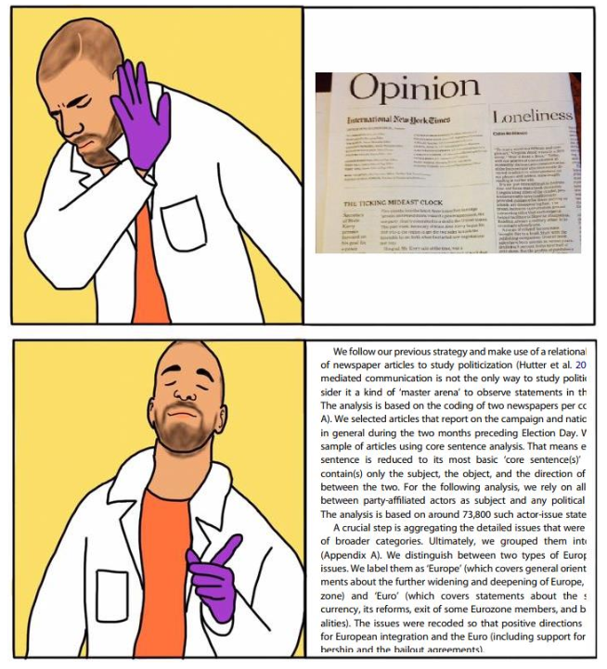

Slide 30
3. Find and Read Literature
What research on your topic has already been done? Which theories conceptualize your question well?
Don’t get lost in the literature: Read the abstract first, then introduction and conclusion, you’ll be able to assess whether the text is useful or not
Make excerpts of the relevant literature

Slide 31
Literature Sources
Databases: Google Scholar, Primo FU Berlin
Journals:
Journal | Impact Factor (2017) | Link
Annual Review of Sociology | 6.773 | https://www.annualreviews.org/journal/soc
American Sociological Review | 5.063 | http://www.asanet.org/research-and-publications/journals/american-sociological-review
American Journal of Sociology | 3.764 | https://www.journals.uchicago.edu/toc/ajs/current
Sociological Review | 2.886 | https://www.thesociologicalreview.com/
European Sociological Review | 2.726 | https://academic.oup.com/esr
Sociology | 2.537 | https://www.britsoc.co.uk/publications/sociology-journal/
Social Forces | 2.156 | https://academic.oup.com/sf/pages/About
British Journal of Sociology | 1.894 | https://onlinelibrary.wiley.com/journal/14684446
Sociological Forum | 1.620 | https://onlinelibrary.wiley.com/journal/15737861#pane-01cbe741-499a-4611-874e-1061f1f4679e01
Journal of Sociology | 1.309 | https://www.journals.uchicago.edu/journals/ajs/about

Slide 32
2. Find a Research Question
Develop an interesting, clear, precise question
Possibilities of narrowing a question: focus on certain people and groups, focus on just one aspect, focus on one regional area
Make sure you have a relevant research question (what is your contribution to the existing literature?) that you can answer in a term paper

Slide 33
2. Find a Research Question
There are different types of research questions:
1. Empirical: test a theory by using data, analyzing discourses, conducting interviews…
2. Theoretical: clarify a controversy, compare theories, test a theory for internal consistency
3. Literature Review: compile knowledge, draw new conclusions from the combination of existing literature

Slide 34
4. Find a Structure & Compose the Text
1) Introduction
  Outline of the problem
  Formulate the precise question
  Explain the relevance of your question
  Introduce the structure of your paper

Slide 35
4. Find a Structure & Compose the Text
2) The Main Part
Present the theoretical and empirical “state of the art”, evaluate the quoted literature and discuss it critically
The main part varies with your type of research question, in general, it is where you do the work, necessary to answer your question (e.g. compare theories, analyze your data..)
In empirical assignments there is a standardized structure: formulation of hypotheses, short description of data, short description of strategy of analysis, operationalization, presentation of the results, interpretation in reference to the theory/in comparison of the cases

Slide 37
4. Find a Structure & Compose the Text
3) Conclusion
Very short summary of the central steps of argumentation
Final discussion that answers your initial question
Outlook

Slide 38
4. Arrange the Assignment
Table of contents
Not more than three subdivisions of a chapter (If you sub-divide a chapter there must be at least two sub-divisions)
All headlines of the assignment must appear in the table of contents
Indicate page numbers

Slide 39
4. Arrange the Assignment
Front page / Cover Sheet with Name of the University, Institute, Lecturer, Seminar, Name, (postal and) email address, your matriculation number, Title, Date of when the assignment has been handed in
Appendix with Graphs and tables that do not necessarily belong into the main part and other material
Bibliography
Author’s confirmation

Slide 40
Further Resources
You will find some sample papers on Blackboard. All the seminar papers, research reports and master theses uploaded there were graded good or very good.
Go to Blackboard > Community > Search for ‘Master “Sociology – European Societies”’ > Enroll > Sample Papers

Slide 41
Written Assignments – Research Placement
Extensive empirical assignment you must hand in at the end of the third semester in module 7 (ca. 30 pages)
Similar structure like a normal term paper, but special emphasis on your own empirical work: collection and analysis of data, presentation and discussion of results

Slide 42
Written Assignments – Master Thesis
The MA thesis should show the capability of the student to:
  work on a sociological research question
  and applies scientific methods
  under supervision but independently
  and to write up an appropriate documentation of the results
It can, but does not have to focus on European Societies
It can be empirical (quantitative or qualitative), theoretical or a literature review

Slide 43
III) Plagiarism

Slide 44
Plagiarism: (Why) is it such a big deal?
Plagiarism is a violation of property rights
Plagiarism is bad scientific practice
Plagiarizing to gain an academic title is considered fraud

Slide 45
Plagiarism
turning in someone else's work as your own
copying words or ideas from someone else without giving credit
failing to put a quotation in quotation marks
giving incorrect information about the source of a quotation
changing words but copying the sentence structure of a source without giving credit
copying so many words or ideas from a source that it makes up the majority of your work, whether you give credit or not
Details: https://www.plagiarism.org/article/what-is-plagiarism

Slide 46
What happens if you plagiarize?
Papers may be checked with an anti-plagiarism software.
Offenders automatically fail the course assignment and cannot repeat the assignment in this particular course.
→ They have to take another seminar in the respective module one year later
Offenders have to see the head of the Examination Board and explain themselves about their act of plagiarism.
In case of serious or repeated plagiarism, the module and thus the whole program will be failed permanently

Slide 47
How can you avoid plagiarism? Content
Excerpt from Bourdieu (1986) Forms of Capital:
“It follows that the transmission of cultural capital is no doubt the best hidden form of hereditary transmission of capital, and it therefore receives proportionately greater weight in the system of reproduction strategies, as the direct, visible forms of transmission tend to be more strongly censored and controlled.”
Direct Quote
[…] The Transmission of cultural capital is […] the best hidden form of hereditary transmission of capital (Bourdieu 1986: 19)
Paraphrase
The transmission of cultural capital within the family is less visible than other forms of capital transmission. Because of this, it is harder to regulate and therefore plays a larger role in the intergenerational reproduction of social class (Bourdieu 1986).

Slide 48
How can you avoid plagiarism? Structure
Content + Structure make a paper unique and distinguishable from other
Also holds true for smaller units (paragraphs)
There are a limited number of possible structures and some scholarly traditions even teach certain structures as particularly valuable. However, students are not allowed to adopt an existing paper or paragraph, leave the structure and just change the words

Slide 49
How can you avoid plagiarism? Ideas
When drawing upon others’ thoughts, the source has to be cited explicitly. This holds for very well-known concepts as well as less known ideas
The theory might be considered common sense, but these sources should still be cited to avoid a charge of plagiarism
Plagiarism does not just happen accidentally, it is a conscious act.

Slide 50
IV) Additional Courses & Resources

Slide 51
Language Courses
Language Center: https://www.sprachenzentrum.fu-berlin.de/en/index.html
Free language courses for FU students during the semester and the semester break
Registration for courses through their website, not Campus Management
For most courses, taking a classification test in advance is mandatory
For this Wintersemester, the registration deadline is the 26th of October at noon (12:00h) for German language courses the deadline has ended on the 20th of October

Slide 52
Language Courses
English, Arabic, French, Spanish etc.
German as a foreign language
  You have to do the onSET-German Einstufungstest (specific date before the beginning of semester)
  Get a course specific to your level
No credits for language courses

Slide 53
Language Courses at Other Institutions
International Summer and Winter University of Freie Universität Berlin (FUBiS)
  http://www.fubis.org/2_prog/term_1/daf/index.html
Berlin European Studies Program of Freie Universität Berlin (FU-Best)
  https://www.fu-berlin.de/en/sites/fubest/prog/courses/00_german.html
Goethe Institut
  https://www.goethe.de/ins/de/en/kur.html
Berlin Adult Education Center (Volkshochschule)
  https://www.berlin.de/vhs/kurse/deutsch-integration/deutsch-lernen/
Technische Universität Berlin
  https://www.zems.tu-berlin.de/sprachen/deutsch/lehrplan_deutsch/

Slide 54
FU:stat
http://www.stat.fu-berlin.de/en/index.html
Statistical Consulting
  Individual consulting for writing term or graduation papers
  Help with finding the right statistical method, applying it correctly to your data and interpreting the results
  Free of charge
  Research question has to be clearly defined in advance
  Agreement of the supervisor of the paper is necessary
Statistic Courses (not available in Winter Semester 20/21)
  At the student‘s expense
  Usually in March and September
We encourage you to take the Stata crash courses offered this semester in the program

Slide 55
UniSport
FU students can participate in sport courses from FU, HU, TU, HTW, Beuth and Uni Potsdam for small fees
A wide range of courses: Ballsport, fitness, yoga, climbing, riding, dancing, water sports, etc.
This website allows to search all courses from those universities
  https://www.unisport.berlin/classes
  https://www.hochschulsport.fu-berlin.de/ → on the right side: “Information in English”
  https://www.buchsys.de/fu-berlin/angebote/aktueller_zeitraum/index.html (FU)
Online registration starts on October 12 at noon
Time period winter term: 02.11.2020-18.04.2021
Special offers during term breaks
Sports classes will take place indoor, outdoor or @Home

Slide 56
Open Lectures and Events
FU open Lectures
  https://www.fu-berlin.de/sites/offenerhoersaal/index.html
HU open Lectures
  https://www.hu-berlin.de/de/studium/beruf/wissenschaftliche-weiterbildung/ringvorlesungen
  No program for this winter term for now
WZB Events
  https://www.wzb.eu/en/events
DIW Events
  https://www.diw.de/en/diw_01.c.621973.en/calendar.html
Humboldt Institute for Internet and Society
  https://www.hiig.de/en/events/
Berlin Institute for empirical integration and migration studies
  http://www.bim.hu-berlin.de/en/events/

Slide 57
Jobs
FU
  https://www.fu-berlin.de/universitaet/beruf-karriere/jobs/
WZB (Berlin Social Science Center)
  https://wzb.eu/en/the-wzb/working-at-the-wzb/job-opportunities
DIW (German Institute for Economic Research)
  https://www.diw.de/en/diw_01.c.618535.en/careers/job_offers.html
TU
  https://www.personalabteilung.tu-berlin.de/menue/jobs/stellenausschreibungen/
HU
  https://www.hu-berlin.de/de/service/arbeit/stellen/standardseite?set_language=de

Slide 58
Student-Service-Center (SSC)
https://www.fu-berlin.de/studium/beratung/ssc/index.html
Central Contact Point for all Requests about your Studies
  Admissions Office
  General Academic Counseling
  International Student Mobility – Welcome Service (changing office hours and availability due to the current restrictions)
    https://www.fu-berlin.de/en/studium/beratung/ssc/_inhaltselemente/ssc/internationale-studierendenmobilitaet.html
  Psychological Counseling (only via phone currently)
    https://www.fu-berlin.de/en/sites/studienberatung/psychologische_beratung/index.html
    Individual Counseling, Workshops, Training Courses
    Issues: Motivation, Making Decisions, Anxiety, Writer’s Block, Procrastination, Stress, Depression..
    Also requests for therapy and finding therapy arrangements
    Staff consists of professional psychologists
    Confidential and for free
Examination Office (Christian Opitz): Christian.Opitz@fu-berlin.de
  Online consultation only

Slide 59
Helpful Links
FU Welcoming Site for International Students
  https://www.fu-berlin.de/en/studium/international/index.html
FU Political and Social Science Exams Office
  https://www.polsoz.fu-berlin.de/studium/pruefungsbuero/index.html

Slide 60
How to behave on campus in times of Covid-19
Only go to the libraries if you have either made a book reservation or a seat reservation online
Only enter university buildings if you have a class or meeting in presence; no seating/ chilling areas available
Bring your own food to campus or queue up in front of one of the tiny restaurants around the corner. All mensas (canteens) are closed to date and there will be no re-opening in the near future.
For further information about Covid-19 restrictions on campus and resulting changes for our Master’s program, please regularly check for updates on our homepage https://www.polsoz.fu-berlin.de/en/soziologie/studium/master/current-information/index.html

Slide 61

Thank you for your attention!
Questions?

